Slide 1
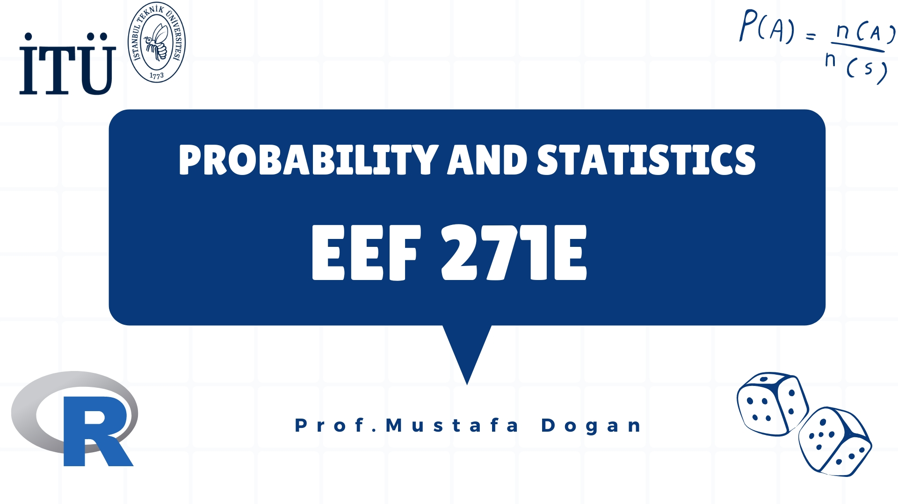

Slide 2
Content
Keynotes about the Lecture
Content of the Lectures
Grading and Rules
Course Description
For Detailed Information

Slide 3
Content
Keynotes about the Lecture
Content of the Lectures
Grading and Rules
Course Description
For Detailed Information

Slide 4
Keynotes about the Lecture
Lecture Name: Probability and Statistics
Time: 08.30-11.30, Tuesday, Fall Semester 2022-2023
Location: MED - (in-class)
Lecturer: Prof. Dr. Mustafa Doğan
(e-mail: mustafadogan@itu.edu.tr mobile phone: +90 (212) 285 3575)
Office: 8106
Office Hour: just contact me via e-mail or call me
Book: John E. Freund's Mathematical Statistics with Applications, 7/E, Irwin Miller, Marylees Miller, PEARSON 2004
Ninova will be actively used and you are responsible to check your e-mails regularly.

Slide 5
Content
Keynotes about the Lecture
Content of the Lectures
Grading and Rules
Course Description
For Detailed Information

Slide 6
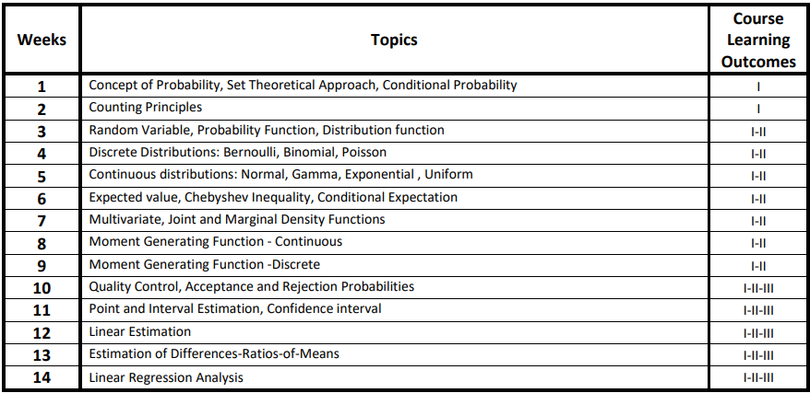
Content of the Lecture

Slide 7
Content
Keynotes about the Lecture
Content of the Lectures
Grading and Rules
Course Description
For detailed information

Slide 8
Grading and Rules
Grading:
30% Midterm Exam #1
30% Midterm Exam #2
40% Final Exam
Rules:
Attendance is not compulsory but encouraged.
Asking question and questioning the lecture are encouraged.
Before exams, there will be Recitation hours.
To avoid VF: A minimum total of 15 points from the semester scores (midterm and homework) (15/55 excluding final examination, event and book)

Slide 9
Content
Keynotes about the Lecture
Content of the Lectures
Grading and Rules
Course Description
For detailed information

Slide 10
Course Description:
Basic probability, axioms and elementary theorems, conditional probability, rule of Bayes; random variables and distributions, Binomial, Poisson and Gaussian distributions; mean and variance of a probability distribution. Continuous random variables, discrete random variables, joint probability density functions. Descriptive statistics, sampling theory, estimation theory, test of hypothesis and significance, claims, tests, and conclusions.
Students who successfully completed this course will be able to: I. Calculate probability of an outcome in a random experiment including Bayesian Theory. II. Obtain the knowledge of the fundamental distributions, apply for advanced statistics. III. Do statistical tests and data analyzes.

Slide 11
Content
Keynotes about the Lecture
Content of the Lectures
Grading and Rules
Course Description
For detailed information

Slide 12
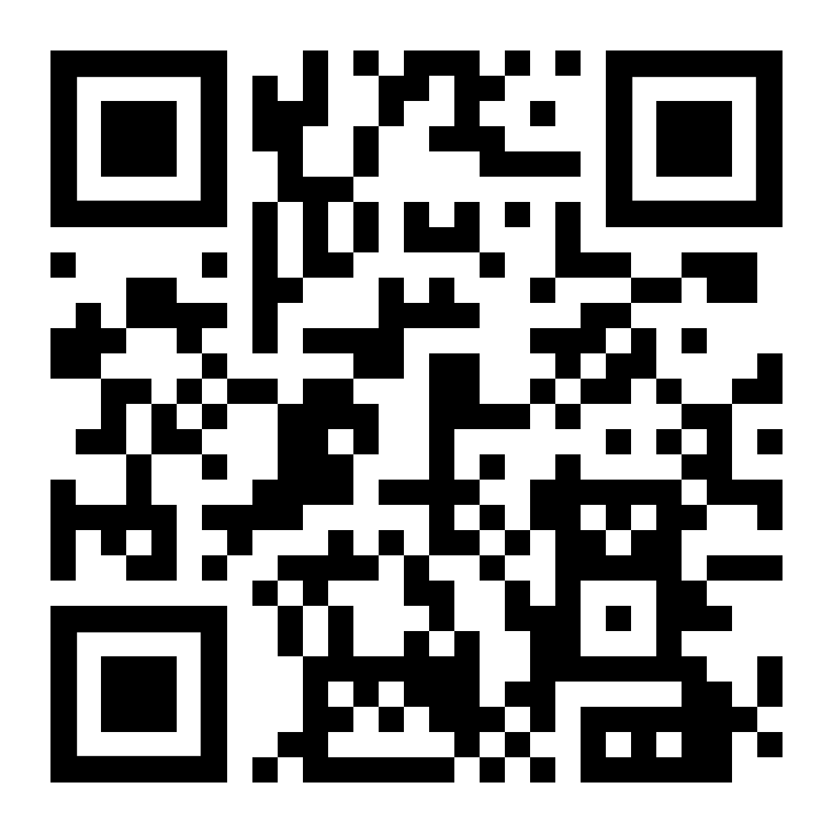
For Detailed Information

